Slide 1
IOT Parking System
CIE 405 Project

Slide 2
Team Members
Mohamed Ali Saleh | 201902216
Gehan Sherif Helmy | 201901989
Muhammad Khalid Anwer | 201901493
Ahmed Mohamed Ibrahem | 201902227
Omar Emad Mohamed | 201901607

Slide 3
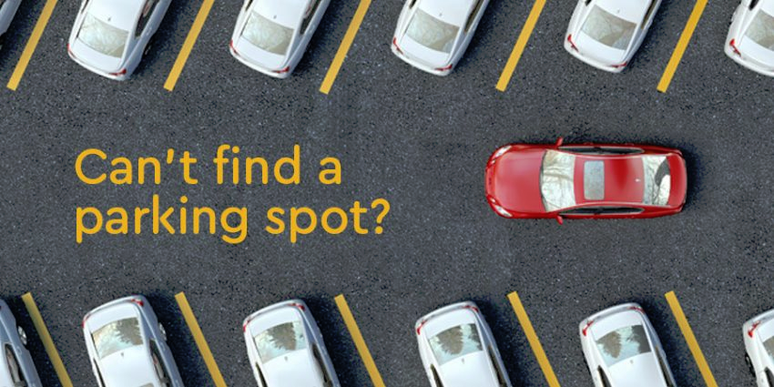
Problem Definition
With The increase in the population vehicle-to-person ratio increased proportionally. Which means more carbon emissions and with an unmanaged parking system this could make the carbon emissions even worse. So we are in need of a smart parking system.

Slide 4
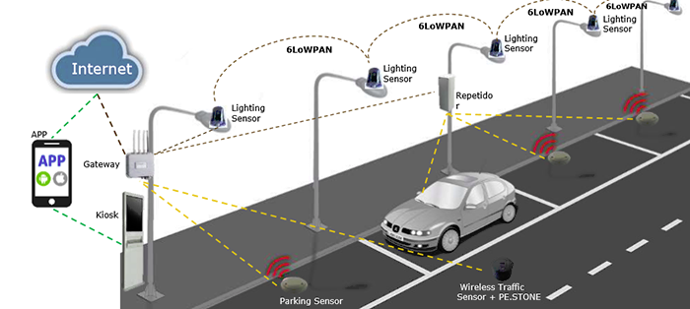
A Possible Solution
If we could indicate to the drivers that this parking lot has no free spots for them we would save the effort of exploring the parking lot, reduce the time needed to park and most importantly reduce carbon emissions.

Slide 5
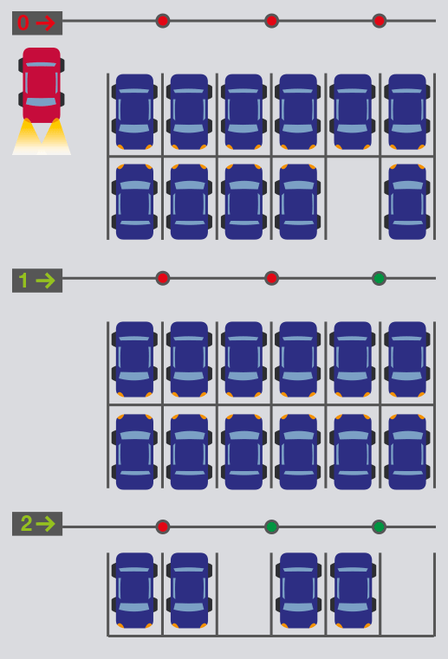
Proposed System
We first detect and count the cars already in the parking lot and then collect this information and send it to either a screen in front of the parking lot or to a cloud which will be then used by a server to tell the driver through a phone app that the state of parking lot.

Slide 6
Miniature of System
To mimic the idea of the system on a small scale we will need the following components.
3 Ultrasonic Sensors
2 IR Sensors
Arduino Uno
Esp 8266
2 Stepper Motors
2 Stepper Drivers
LCD screen
A LOT of jumpers
Breadboard
3 Toy Cars

Slide 7
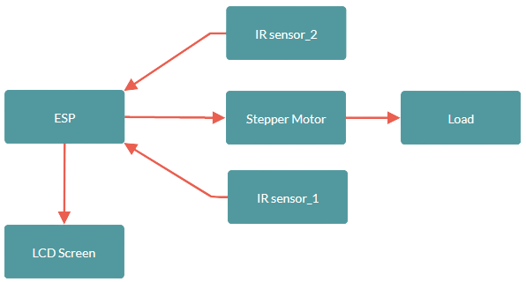
Block Diagram (Old)
Note: we added three ultrasonic sensors to detect vehicles parked and an arduino Uno to provide sufficient pins.

Slide 8
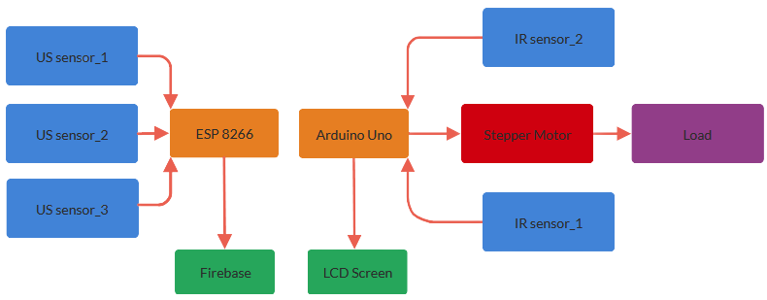
Block Diagram (New)
Sensors
Display
Microcontrollers
Actuators

Slide 9
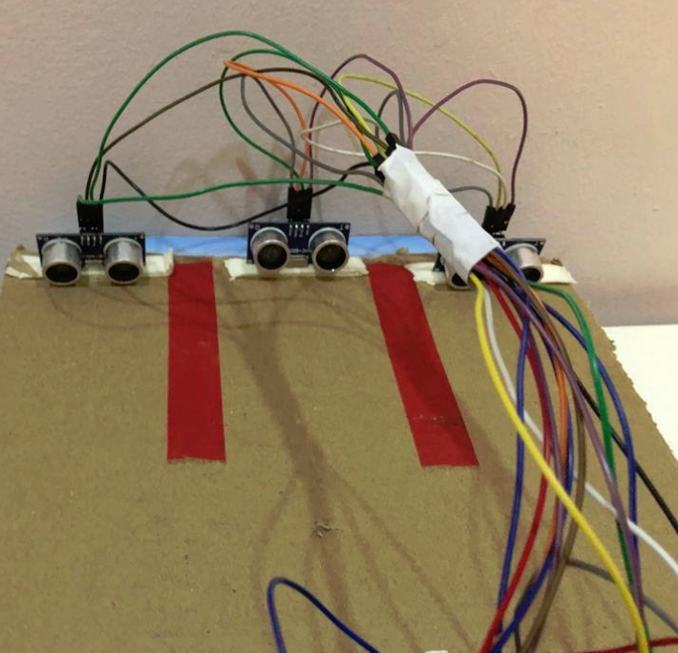
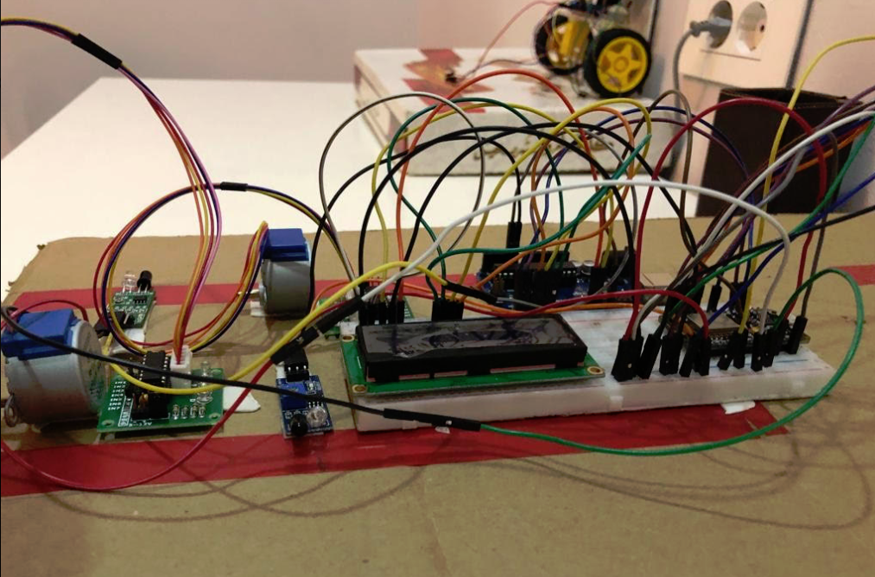
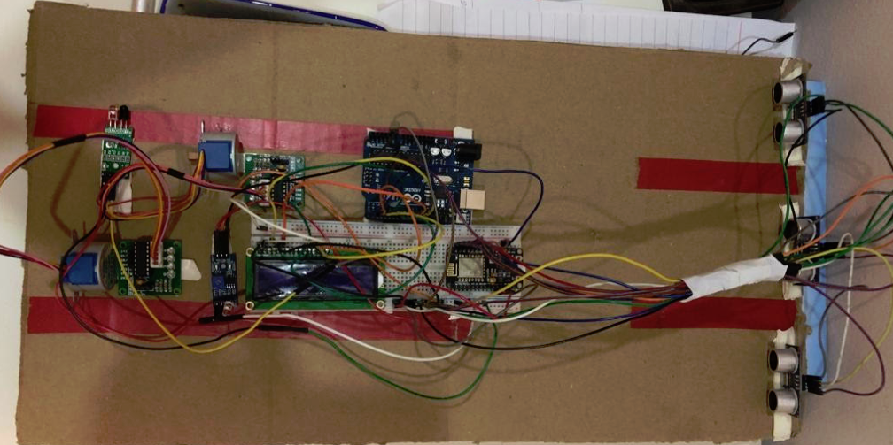
Current Setup
Front View | Side View | Top View

Slide 10
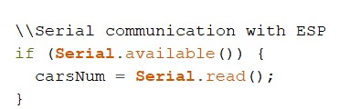
Arduino Code (Motor & Sensors)
//open the gaaaaaaaates
stepper.moveTo(stepsPerRevolution);
while(stepper.distanceToGo() != 0)
{
stepper.run();
}
//close the gates after a small delay
delay(1500);
// check current stepper motor position to invert direction
stepper.moveTo(-stepsPerRevolution);
while(stepper.distanceToGo() != 0)
{
stepper.run();
}
delay(3000);
Serial Communication to esp

Slide 11
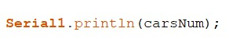
ESP Code
\\Detect a vehicle with Ultrasonic sensor 1,2 and 3
if(distance1 < US_threshold) //if a car stands in the lane1
{
//setting the status of the lane to full
Firebase.setString(firebaseData, "Lane1", "full");
}
else
{
//setting the status of the lane to empty
Firebase.setString(firebaseData, "Lane1", "empty");
}
Ultrasonic Detection Code
digitalWrite(trigger3, LOW);
delayMicroseconds(2);
digitalWrite(trigger3, HIGH);
delayMicroseconds(10);
digitalWrite(trigger3, LOW);
duration3 = pulseIn(echo3, HIGH);
distance3 = duration3 * 0.034 / 2; // Speed of sound wave divided by 2 (go and back)
Serial Communication to arduino

Slide 12
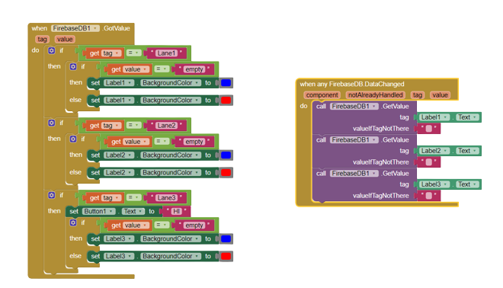
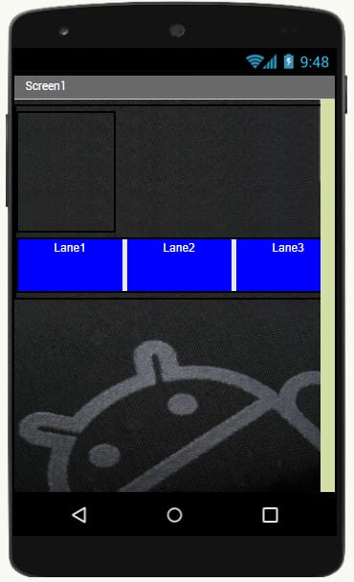
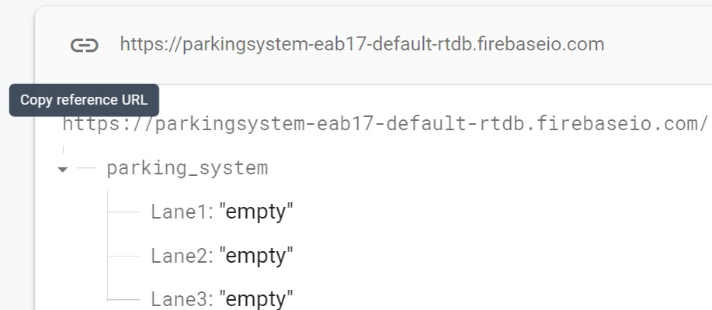
MIT App Inventor & firebase

Slide 13
Motor Selection
This motor selection process is very similar to that of arm robot but with a single joint.
If we were to implement the this project in a parking lot,motor selection is the most important step.
First we would start by measuring the Width of Passage Clearance to determine the length of the barrier and its weight. From weight and length of barrier we can easily determine the torque needed to move the barrier.
then we would assume that the barrier should rotate 90 degrees in 2-3 seconds which translates to 10-15 rpm.
Lastly, we have the torque needed to actuate the barrier and a reasonable rpm to do so now we can start motor selection.

Slide 14
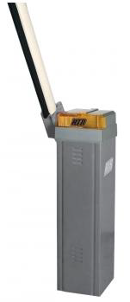
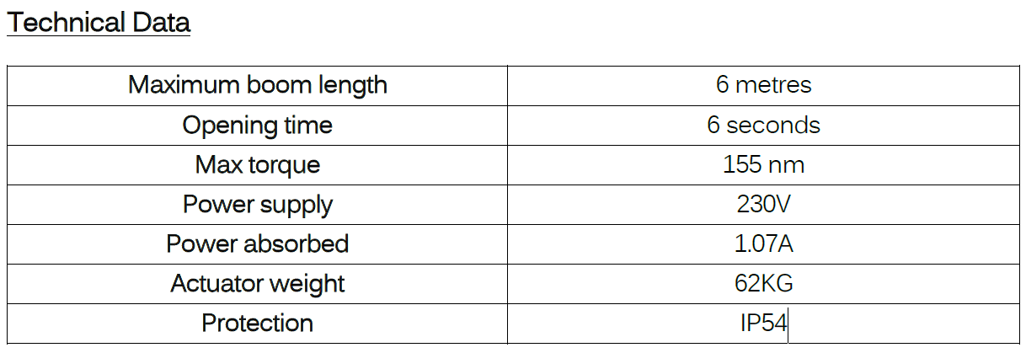
Automate Barrier Examples
Rapid-N Barrier
Link for manuals

Slide 15
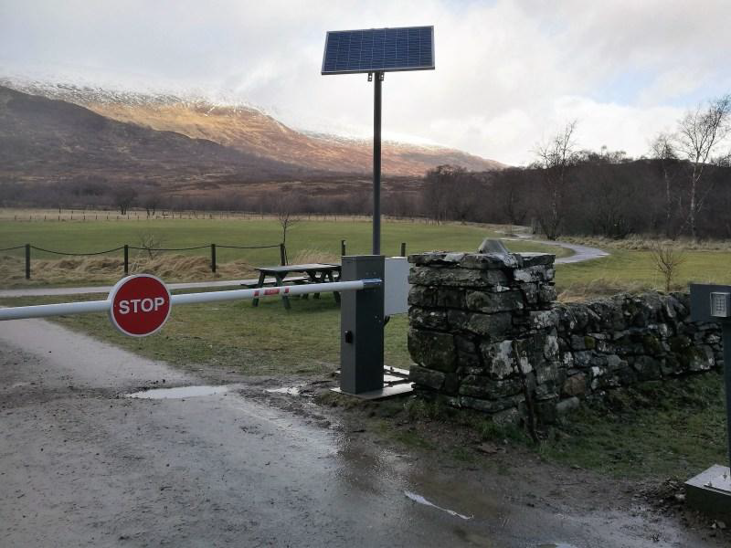
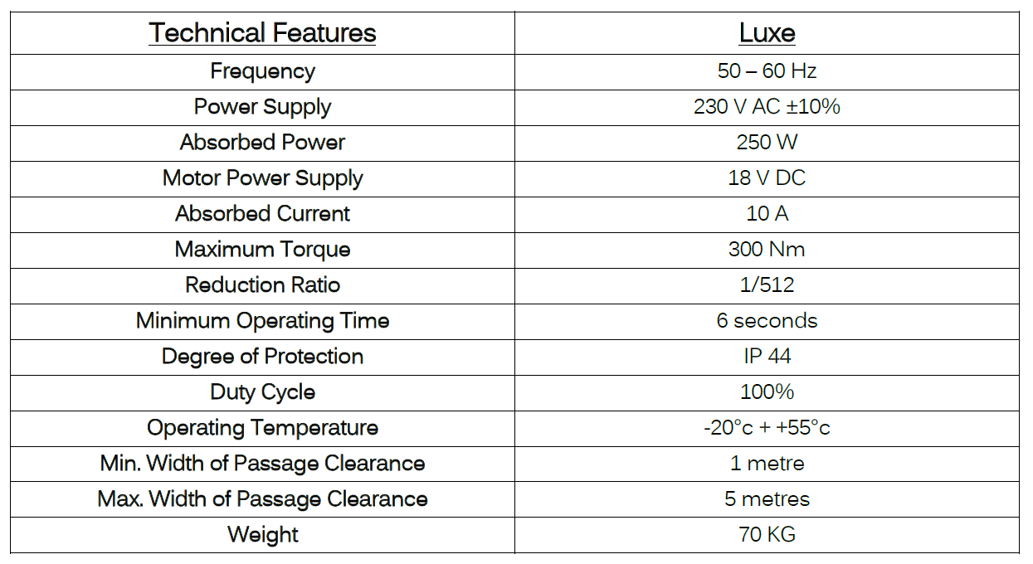
Solar Powered Barrier

Slide 16
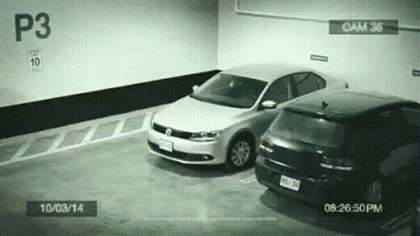
THANKS!
We found the optimal parking spot!

